Slide 1
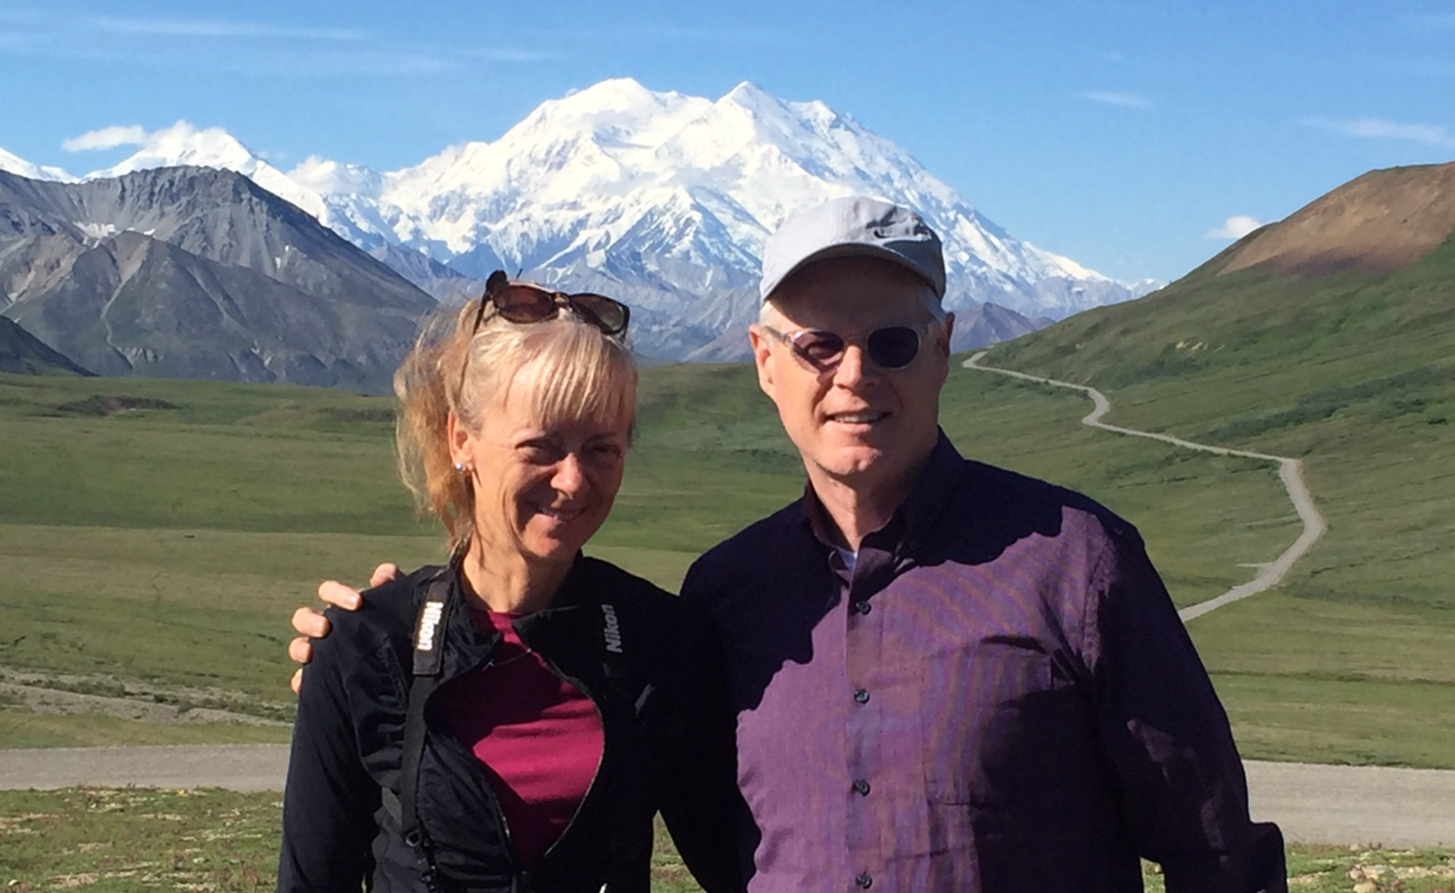
London
Field Forum
“On a Divine Adventurer with Jesus”
France & Germany in London
Rick and Cheri Mann

Slide 2
Our hopes for this week…
You can find rest for your body and soul.
You can find renewal in your spirit.
We can raise the ceiling on our level of faith (greater expectancy)
  Individually and as teams
  “They overcame by the Blood of the Lamb and Their Testimony”
  God is always doing great things around us even we don’t see it
We can grow in our awareness and intentionality.
We can see growth in your spiritual toolbox and strategic toolbox.
Bottom Line: We want to experience more of Jesus this week.
NOTE: Format is talk some (lecture) and process some (lab)

Slide 3

Rick Mann: Brief Intro
Be with Jesus / Become like Jesus / Do what Jesus did
Rick was a hellion growing up (17/18/20/21) / Cheri was Lutheran (16, 20, 21) (Hellion: a rowdy or mischievous person, especially a child.
Fairhaven: Opportunity for Christian teachers in China (Tom Stebbins) MDiv / MA / PhD
Rick was a cessationist. (Don’t send them to China)
After 5 years: Rick doesn’t want to be a Christian, married, or a missionary. “I’m out”
Boxed them up and sent them to Link Care (Counseling / Healing / Renewal)
We met the Vineyard: John Wimber: “Just read the Gospels and do what Jesus did”
Discovered an Alliance/biblical worldview (Martin Sanders, Ron Walborn, Rob Reimer)
Leave the Alliance? No (Ron Walborn). Go and pastor an Alliance church as though it is a Vineyard. Six wonderful years.
Gary Benedict: Have you ever thought about being a college president? 13 tough years. MBA
Mike Plunket: Crown is not the best version of you.
Cheri: We need to move to a warmer place.
Trevecca: MBA/DBA faculty role.
Leadership Development with Rob Douglas
Jan 2023: Best Decade Ever #bde
  Grow in awareness and intentionality (AI)
  Kingdom Normal: Saved, Healed, Delivered
  Multiplying Spiritual/Strategic Alliance Leaders

Slide 4
Lunch (in the DR) with Tim Crouch
“Rick, could you help with a few searches we are doing?”
“Yes, but for me the bigger question is what are we doing to develop more Alliance leaders”
Discussion: Rick, Tim Meier, Rob and Stacy Douglas, Ted and Sandy Kang
Strategic Leadership Incubator
  They are fine spiritually
  They need to build their strategic toolbox
We need to build both the spiritual and strategic toolboxes of our Alliance leaders (starting with AM)
Rebranded ASCENT Leadership Lab

Slide 5
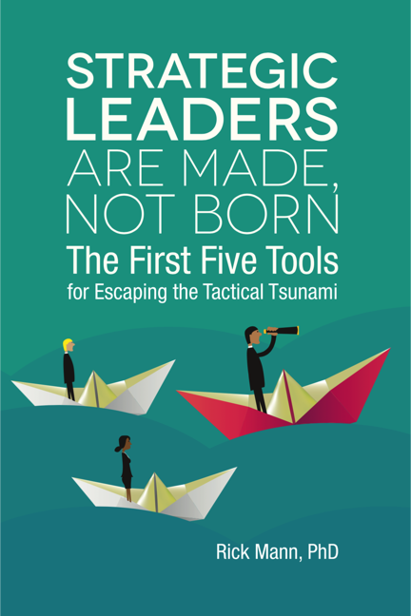
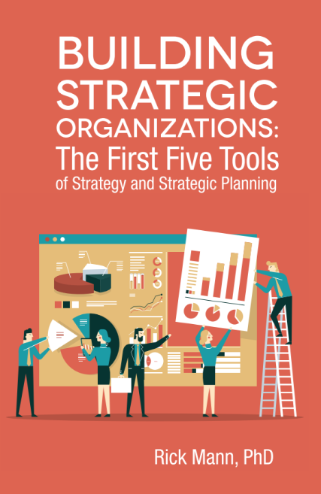
Problem Addressed:
“Statistics show that fewer than 10% of leaders exhibit strategic skills, a woefully inadequate number considering the demands on organizations today.
The job of strategy is not limited to a few top executives. Strategic leaders are needed throughout our organizations if they are to adapt, innovate and succeed well into the future.”
Kate Beatty
Author of ”The Three Strengths of
a True Strategic Leader” Forbes

Slide 6
Building the Strategic Capacity of You and Your Team
The initial goal of SLI (Build strategic capacity of ministry leaders)
Grow the Spiritual and Strategic Leadership of Alliance Leaders
  Marketplace (2023 cohort)
  4 AM Specialties (2024 cohort)
  US District and National Office Leaders (2025 cohort)
  US Cohort (2026)
  AWF Cohort (2027)

Slide 7
Spiritual and Strategic Leadership
(Christ-centered, Spirit-filled, Healthy Strategic Leaders)
Empowered
Spiritual
Leadership
Enterprise
Leadership
Growing Scale ➤
Growing Anointing ➤
Spirit-filled
Leadership
Healthy
Leadership
Strategic
Leadership
Foundational
Spiritual
Leadership
Tactical
Leadership
Spiritual Leadership
Strategic Leadership

Slide 8
“Multiplying Christ-centered, Spirit-filled, Healthy, Strategic Leaders”
Christ
Centered
Spiritual
Leaders
Strategic
Leaders
Healthy
Leaders
Multiplying
Leaders

Slide 9
C&MA: Christ-centered, Acts 1:8 Family
Spiritual
Strategic
But you will receive power when the Holy Spirit has come upon you,
and you will be my witnesses in Jerusalem and in all Judea and Samaria, and to the end of the earth.”

Slide 10
AI Redefined (This is enough for this week)
AI = Artificial Intelligence
Redefined: AI = Awareness and Intentionality
  Self-Awareness: Understanding Yourself
    Do you know your own heart? Do you know how others experience you?
      “Rick, you think too fast, talk too fast, and walk to fast.” Gary Benedict
  Other-Awareness: Understanding those around you and your interaction with them.
    How is your team doing? What are your opportunities and challenges (Relationally and strategically?)
  God-Awareness: What is God doing around me and others.
    God, what are you saying to me…

Slide 11
Lab Time (10 minutes)
2-3 people in a group, not 4 (not someone from your family)
Discuss together (Growing Awareness)
  How are you feeling coming into this week? (Self-awareness)
  What are you sensing from the Lord these days? (God-awareness)

